Slide 1
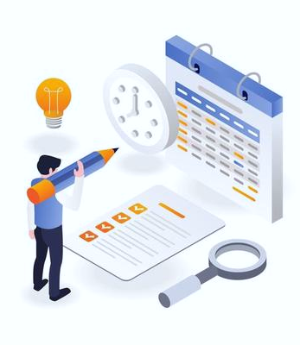


Timetable Generator for DA-IICT
Mentor: Prof. PM Jat
By: 202001134 - Hardik Prajapati

Slide 2
What have you done?
Database Design
Development with Django
Customizable Options
Testing
Documentation
Implemented a database to store course details, faculty information, and other essential data required for timetable generation.
Developed the backend using Django which ensures efficient timetable generation, accommodating various constraints and preferences.
By combining automation and manual intervention, we aim to provide administrators with a flexible solution to meet unique scheduling requirements.
GUI testing was done by team to ensure the reliability and accuracy of the timetable generator.
We provided comprehensive documentation that includes objective, functionalities, system design and future works for our system.
2

Slide 3
What have you learned?
Team Collaboration
Continuous Improvement
Collaborating as a team taught us the importance of effective communication, task delegation, and project management.
Identifying areas for enhancement and considering future works allowed me to envision a more advanced timetable generator.
Development with Django
I gained hands-on experience in using Django, to build a functional and interactive web application.
Semi-Automation
Real-World Application
The project provided me with a real-world application of the programming concepts learned in our academic studies.
I learned that while automation streamlines the process, manual intervention enables customization and flexibility.
3

Slide 4


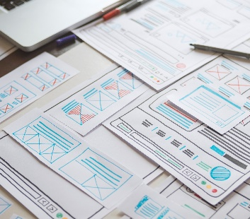
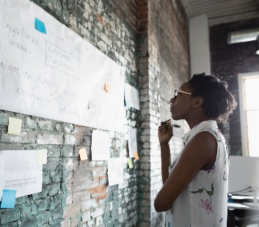
Thank you

